Slide 1




HELLO MY TAC-TIC-TOE GAME
Ranen Al-Khlabi
SEI

Slide 2

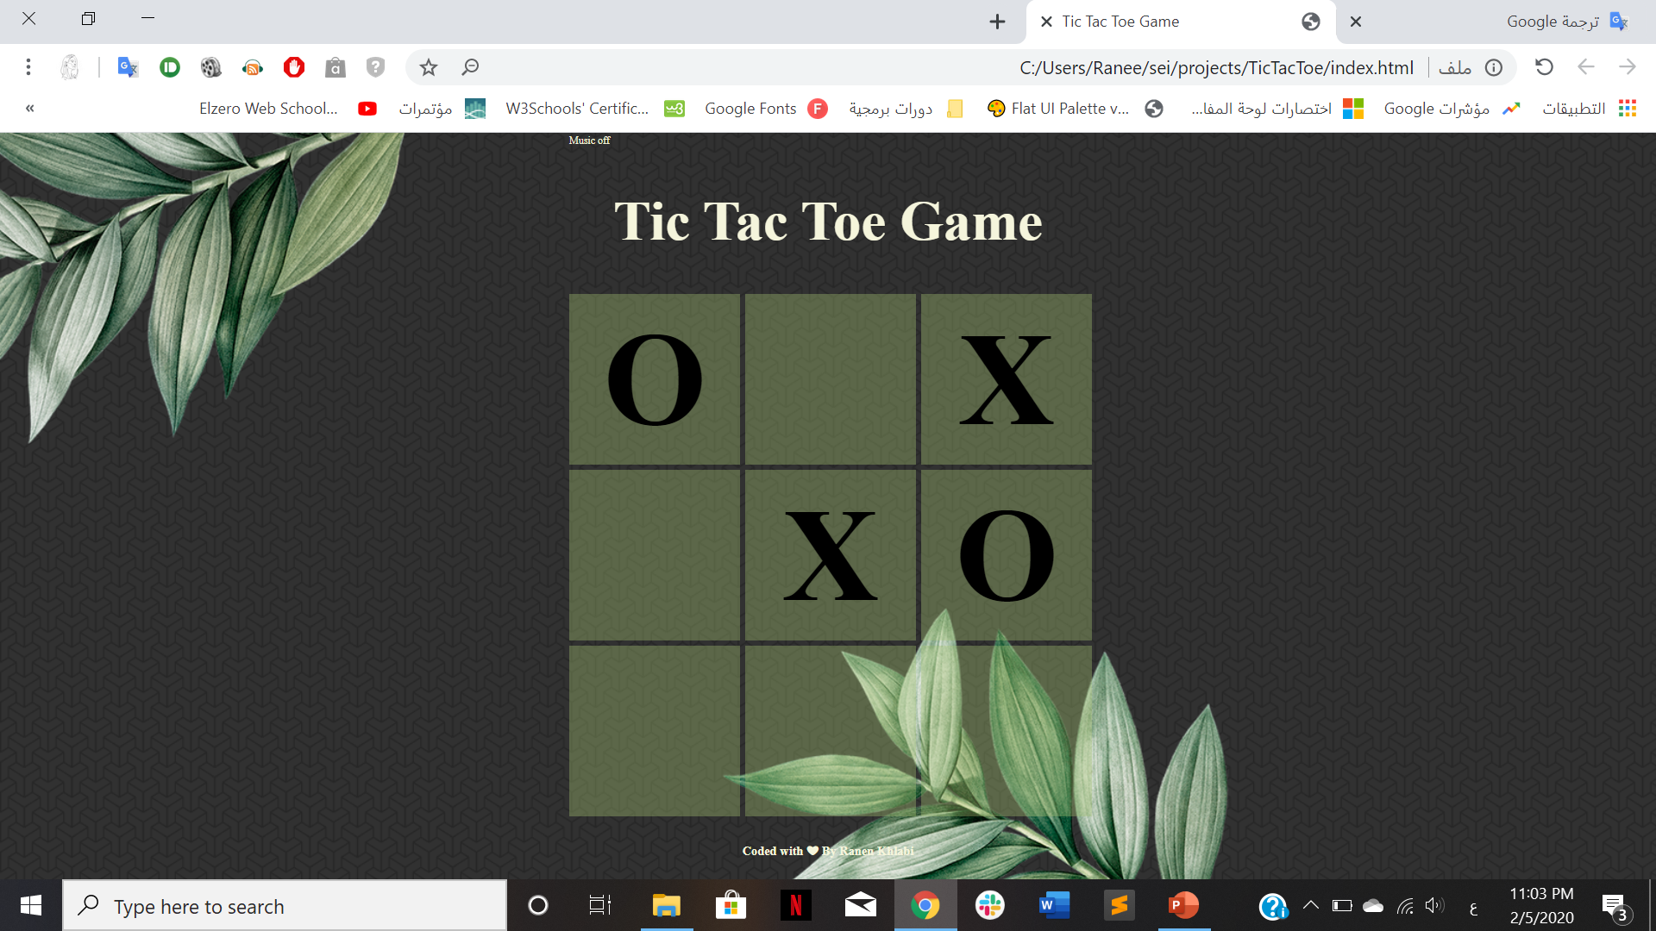
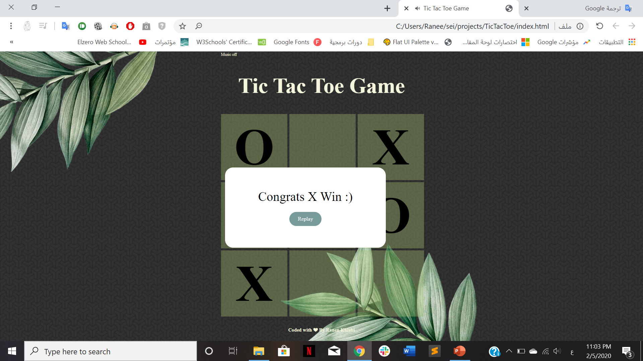
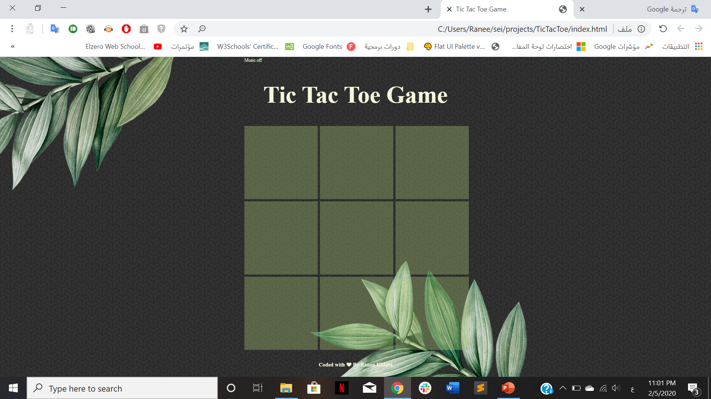

Slide 3
What was your favorite part to work on?

Slide 4
What was the most difficult part of the project?

Slide 5
What would you like to add next?

Slide 6
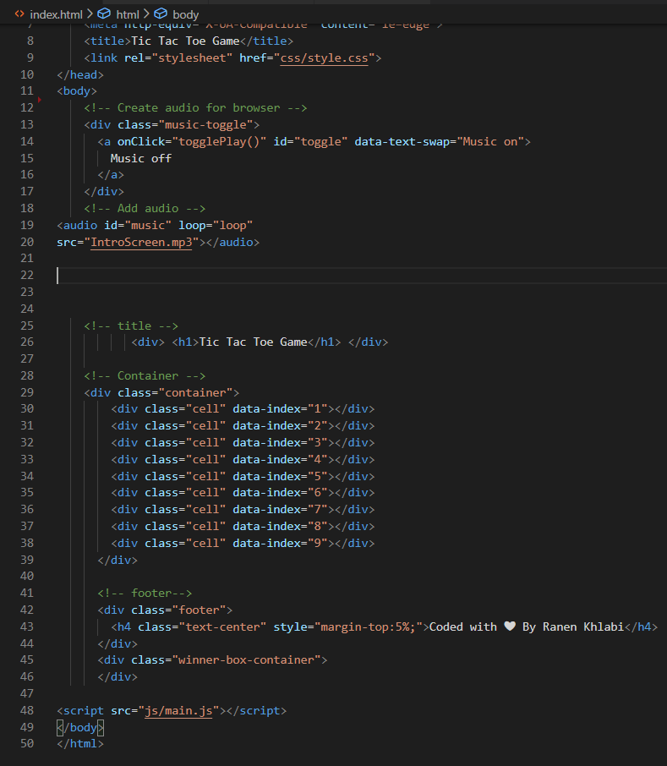
HTML Page

Slide 7
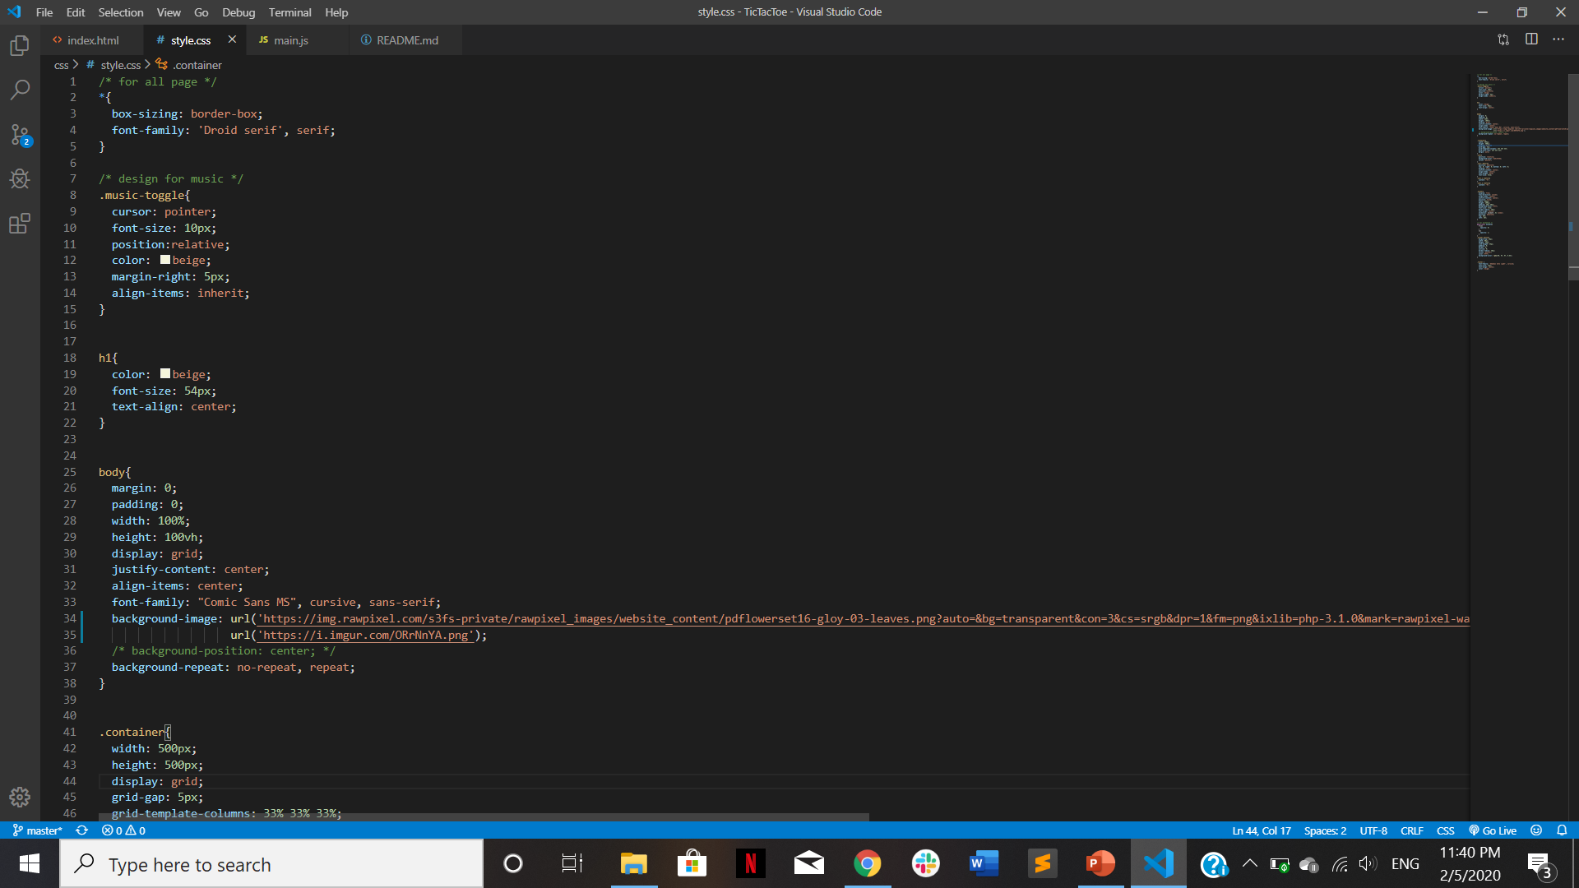
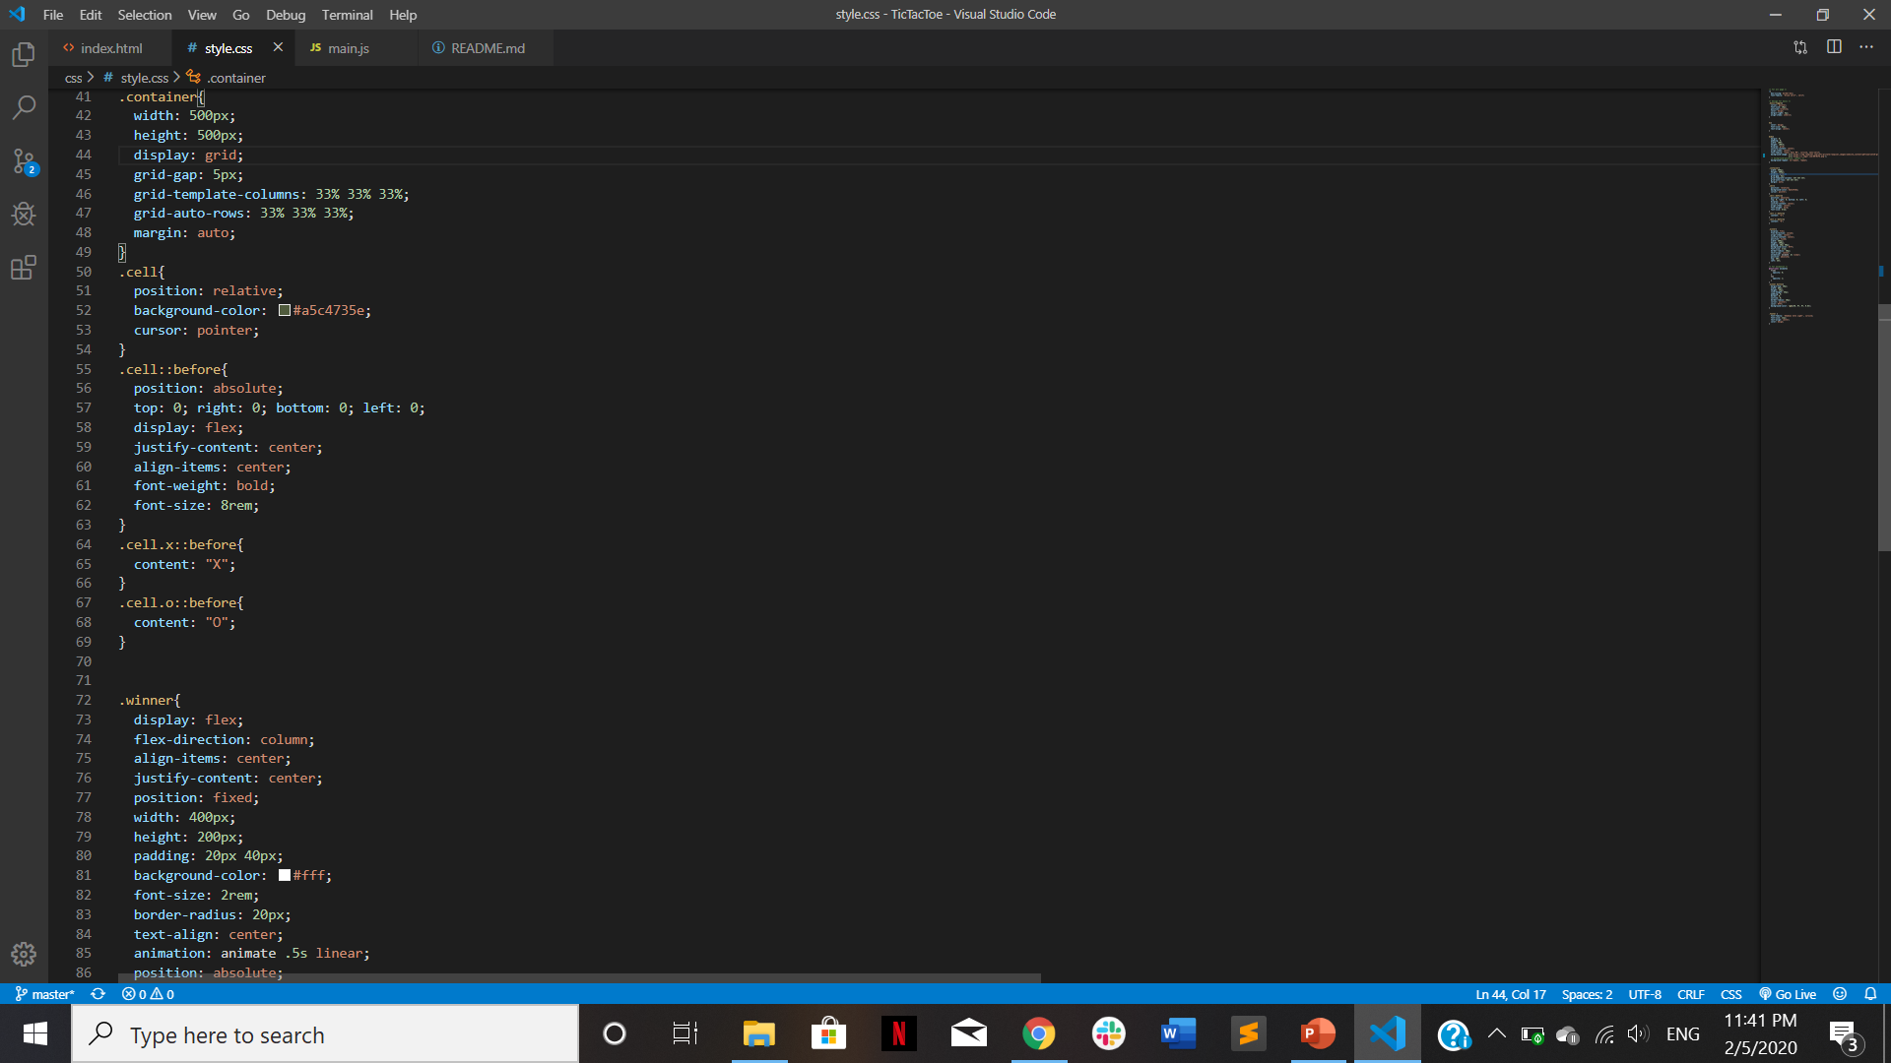
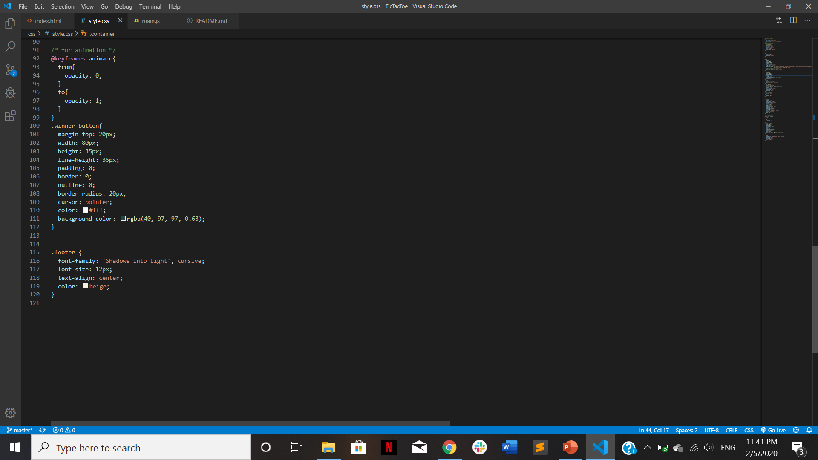
CSS Page

Slide 8


